Slide 1
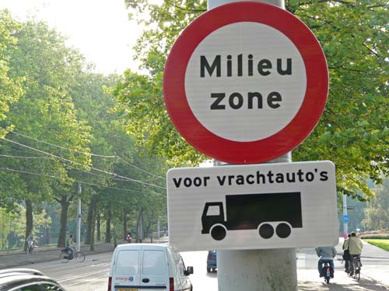
Low emission zones in Dutch cities
Approach and experiences
Paul Poppink

Slide 2
Approach: National agreement
2005: plans for LEZ’s in many cities: chaos loomed
2006: Initiative by national government for national agreement
Endorsed by:
2 Ministries
10 cities (later 15)
Transport organisations TLN, EVO

Slide 3
Agreement: goals
Uniform entry regulations for LEZ’s
Uniform decision processes for introduction LEZ’s (‘road map’)
Not only limitations, but also positive measures for city distribution
Subsidies for soot filters, Euro IV, Euro V
Obligations for cleaner community vehicles and public transport (buses)

Slide 4
Agreement: important elements (1)
For lorries > 3,5 tonnes
Entry criteria:
From July 2007:
No Euro 0, I
Euro II and III only with soot filter
Free entry for Euro IV, V
From January 2010:
No Euro 0, I, II
Euro III only with soot filter, and < 8 years old
Free entry for Euro IV, V
From July 2013:
Only Euro IV and cleaner

Slide 5
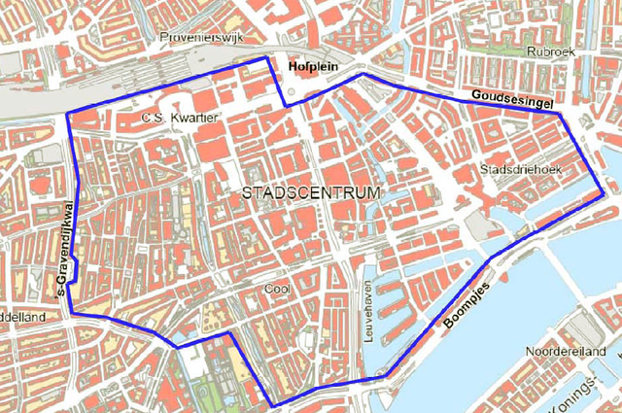
Agreement: important elements (2)
National and local exemptions
Introduction LEZ only in consultation with business sector (TLN, EVO):
According to ‘road map’
Only if lorries have a significant share in local concentrations of PM₁₀ and NO₂
Boundries LEZ jointly determined

Slide 6
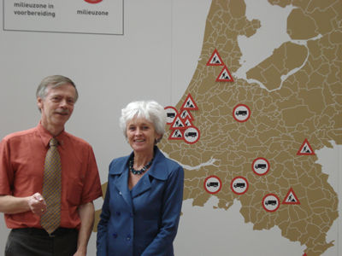
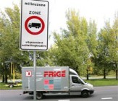
State-of-affairs
LEZ’s in 12 cities
Foreign vehicles still excluded
Coaches excluded
In 2013 scope LEZ’s likely extended to vans

Slide 7
Experiences
Agreement works well overall
Only LEZ’s where required
Uniformity with some degree of flexibility
Some compensation for transport operators (subsidies)
Cities are reluctant with positive measures
Effects on air quality are less than expected
Average effect in 2010: PM₁₀ NO₂
Share of lorries in urban traffic is lower (3-5%)
Euro V performs less well in urban traffic
Soot filters decrease emissions PM₁₀, but increase NO₂

