Slide 1
Enhanced transport quality and tramway energy efficiency by multi-modal traffic management systems
Christian Gassel, Dipl.-Ing.
Faculty of Transportation and Traffic Sciences „Friedrich List“, TU Dresden
Notes:
Mr. Chairman, Ladies and Gentlemen,
my contribution is called Additional benefit of ITCS data used in road traffic control systems. It was elaborated at the Institute for Transport Telematics at the Dresden University of Technology. I want to summarize a current research project in Dresden, Germany where local institutions figure out the advantages of a multimodal traffic monitoring system.

Slide 2
◆ Background
Brisk demand for Intelligent Transport Systems (ITS) within the last years
“ Intelligent Transport Systems can significantly contribute to a cleaner, safer and more efficient transport system” [European Commission Mobility and Transport]
Broad support for ITS by European Commission, member states and local authorities
ICT Work Programmes
ITS Action Plan COM(2008)886 and Directive 2010/40/EU
National Research Programmes
…

Slide 3
◆ Background
Road Traffic Management
Vehicle Electronics
Payment Systems
Traveller Information
Intelligent Road
Infrastructure
Freight and Commercial Transport
Vehicle Safety
Public Transport Operation

Slide 4
◆ Background
Road Traffic Management
Vehicle Electronics
Payment Systems
Traveller Information
Intelligent Road
Infrastructure
Freight and Commercial Transport
Vehicle Safety
Public Transport Operation

Slide 5
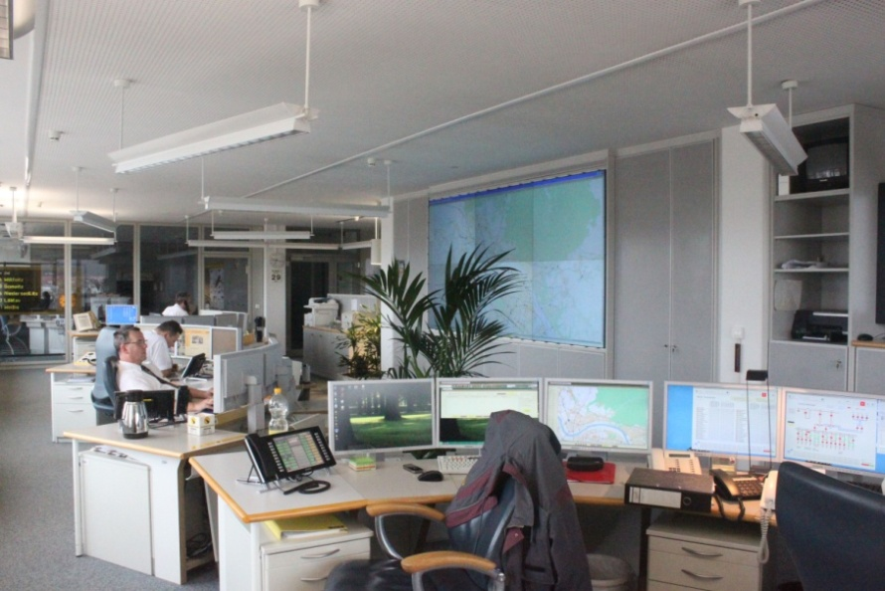
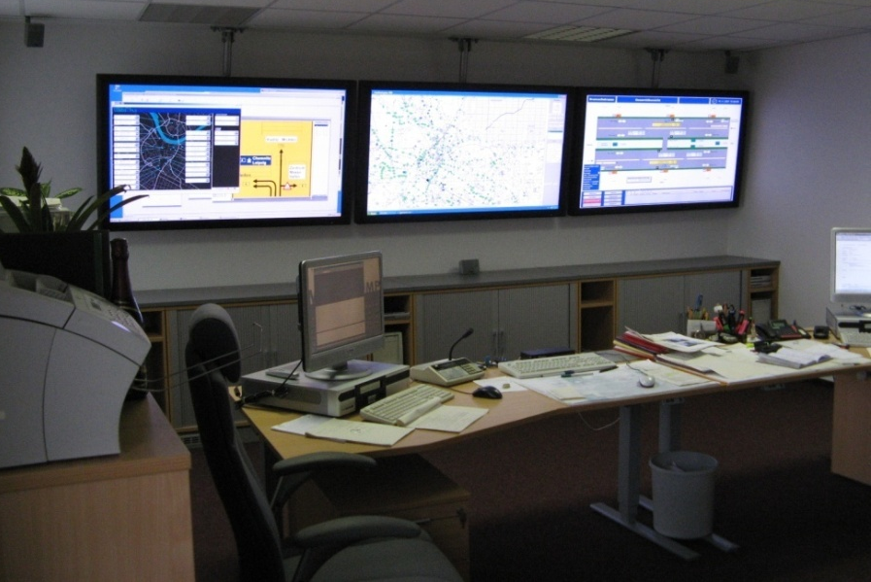
◆ Background
ITCS and TCC Systems – both used to save high transport quality
ITCS
(Intermodal Transport Control System)
- Locate and dispatch vehicle fleet
- Passenger Information Services
TCC
(Traffic Control Centre)
- Road traffic condition monitoring
- Derive measures to improve traffic flow

Slide 6
◆ Background
Intermodal Transport Control System
ITCS
(Intermodal Transport Control System)
- Locate and dispatch vehicle fleet
- Passenger Information Services
TCC
(Traffic Control Centre)
- Road traffic condition monitoring
- Derive measures to improve traffic flow

Slide 7
◆ Background
Intermodal Transport Control System
ITCS
(Intermodal Transport Control System)
- Locate and dispatch vehicle fleet
- Passenger Information Services
Dresden ITCS System:
Monitoring of 12 tramway routes and 28 bus routes

Slide 8
◆ Background
Traffic Control Centre
ITCS
(Intermodal Transport Control System)
- Locate and dispatch vehicle fleet
- Passenger Information Services
TCC
(Traffic Control Centre)
- Road traffic condition monitoring
- Derive measures to improve traffic flow

Slide 9
◆ Background
Traffic Control Centre
TCC
(Traffic Control Centre)
- Road traffic condition monitoring
- Derive measures to improve traffic flow
Dresden TCC System
traffic flow detection
single- and multi-induction loops, infra-red and video detection, taxi FCD (about 1200 sensors)
Traffic control & information
changable traffic signs, parking information,…

Slide 10
◆ Background
TCC with poor knowledge of Public Transport issues
ITCS
(Intermodal Transport Control System)
- Locate and dispatch vehicle fleet
- Passenger Information Services
TCC
(Traffic Control Centre)
- Road traffic condition monitoring
- Derive measures to improve traffic flow
Project approach:
Improve traffic quality by differentiated priorities at traffic lights depending on
Private transport conditions
Punctuality of Public Transport
Dynamic connection services
and reduce energy consumption of trams

Slide 11
◆ Multimodal System Architecture
Multimodal System Architecture
ITCS
Bus/tramway positioning data
Multi-modal interface module
Public transport
approaching model
Priority decision
system
Public transport
approaching
prognosis
Current road
traffic situation
Traffic Control Centre
Traffic flow
detection
Notes:
In urban agglomerations ITCS systems and Traffic Control Centres are installed to save high transport quality

Slide 12
◆ Multimodal System Architecture
Priority Decision System
7-stage-priority system for each public transport vehicle approaching an intersection
Punctuality
Headway regularity
Connection services
Private transport conditions (LOS A…F)
Simplified example:
Tram delayed and LOS A/B for road traffic: High priority for tram
Tram before schedule: Low tram priority
Commutation into realizable modifications of the ordinary signal timing plan
Modification options given by Urban Road Department
Modifications coded in traffic light login-telegrams and interpreted by traffic light controllers
ITCS
TCC
Notes:
In urban agglomerations ITCS systems and Traffic Control Centres are installed to save high transport quality

Slide 13
◆ Multimodal System Architecture
ITCS
Bus/tramway positioning data
Time remaining until next green stage Dynamic connection services
Multi-modal interface module
Public transport
approaching modell
Priority decision
system
Traffic computer
Traffic light
controller
Public transport
approaching
prognosis
Current road
traffic situation
Traffic Control Centre
Traffic flow
detection
Notes:
In urban agglomerations ITCS systems and Traffic Control Centres are installed to save high transport quality

Slide 14
◆ Energy-Efficient Light-Rail Control
3. Energy-Efficient Light-Rail Control
Driver Advisory Systems already used in railways and metro systems (savings: 5-10%)
Maximum Principle of Pontryagin useful for Light-Rail / Tramway environment
Acceleration
Cruising
Coasting
Speed
Braking
Theoretically and practically proved: Horn/Strobel (1974);
Kraft/Schnieder (1981); Howlett (1994); Sanftleben (2002);
Albrecht (2006)
Find switching points between the regimes ensuring on time arrival at next target point
- Arrival time at the next tramway stop
Green stage at the next traffic light
Position
Notes:
In urban agglomerations ITCS systems and Traffic Control Centres are installed to save high transport quality

Slide 15
◆ Energy-Efficient Light-Rail Control
100
80
60
tmin
Minimum contraint for the solution space: minimum running time
Time /s
40
20
0
0
100
200
300
400
500
Position /m
60
50
40
Speed /km/h
30
20
10
0
0
100
200
300
400
500
Position /m
Traffic lights
Notes:
In urban agglomerations ITCS systems and Traffic Control Centres are installed to save high transport quality

Slide 16
◆ Energy-Efficient Light-Rail Control
100
80
60
tmin+5s
Time /s
40
20
0
0
100
200
300
400
500
Position /m
60
50
40
Speed /km/h
30
20
10
0
0
100
200
300
400
500
Position /m
Traffic lights
Notes:
In urban agglomerations ITCS systems and Traffic Control Centres are installed to save high transport quality

Slide 17
◆ Energy-Efficient Light-Rail Control
100
tmin+30s
80
60
Time /s
40
20
0
0
100
200
300
400
500
Position /m
60
50
40
Speed /km/h
30
20
10
0
0
100
200
300
400
500
Position /m
Traffic lights
Notes:
In urban agglomerations ITCS systems and Traffic Control Centres are installed to save high transport quality

Slide 18
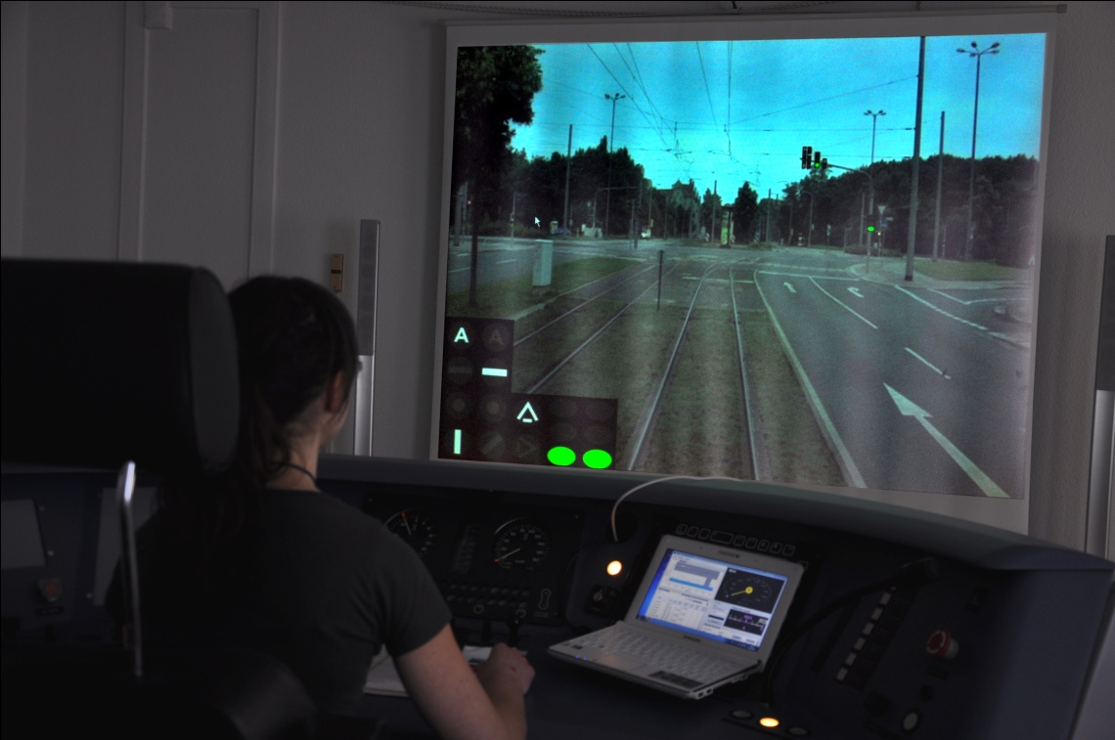
◆ Energy-Efficient Light-Rail Control
Human Engineering Aspects
Dynamic signalling
scenarios
Speed
High distraction risk when giving a large variety of information
Advice: departure, cruising (only below maximum speed), coasting
vcr,min>0,5*vmax !
Position
Notes:
In urban agglomerations ITCS systems and Traffic Control Centres are installed to save high transport quality

Slide 19
◆ Case Study Nürnberger Platz
4. Case Study Nürnberger Platz
Berlin
4
Leipzig/
Chemnitz
17
Prag
Notes:
In urban agglomerations ITCS systems and Traffic Control Centres are installed to save high transport quality

Slide 20
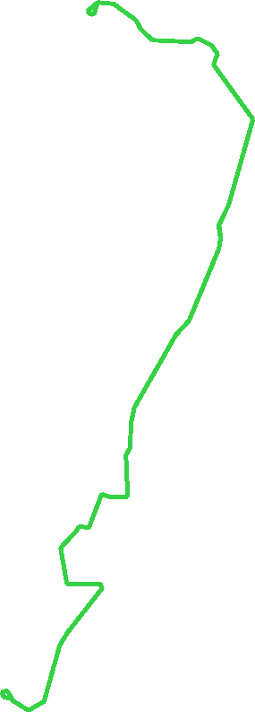
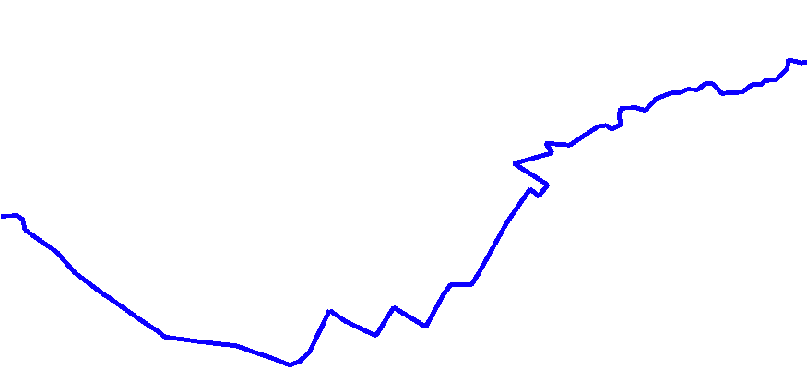
◆ Case Study Nürnberger Platz
4. Case Study Nürnberger Platz
8
3
ADT major road: 28000 vehicles
ADT minor road: 10000 vehicles
3 PT lines (3, 8, 61)
Connection service (8 › 61)
Traffic Control: Vehicle actuated, partly restricted
61
Notes:
In urban agglomerations ITCS systems and Traffic Control Centres are installed to save high transport quality

Slide 21
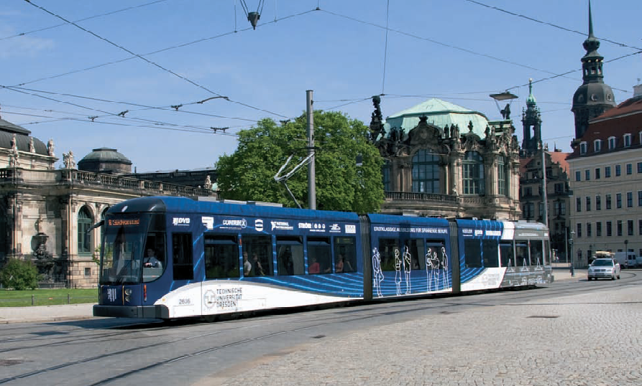
◆ Case Study Nürnberger Platz
Driving Behaviour Analysis
Data collection by Dresden Measuring Tram (in ordinary operation)
5-year data collection:
- Lateral, longitudinal and vertical acceleration
- Longitudinal position
- Speed
- Voltage at pantograph
- Total vehicle current
- Braking power
Status track brake
GPS-signal
…
Source: DVB AG(2009)
Notes:
I’ve divided my presentation into five parts. After a short introduction I would like to give you an overview on the Multimodal system architecture and the benefit for energy efficient Light Rail Control. And finally I would like to show you a case study where the system currently is implemented in practice.

Slide 22
◆ Case Study Nürnberger Platz
Line 8 Direction Südvorstadt
v-s-Diagram
60
50
40
Velocity /km/h
pstop= 65…100%
30
20
10
0
600
500
400
300
200
100
0
Distance to Nürnberger Platz /m
REI
REI
FLP
NUP
NUP
Notes:
I’ve divided my presentation into five parts. After a short introduction I would like to give you an overview on the Multimodal system architecture and the benefit for energy efficient Light Rail Control. And finally I would like to show you a case study where the system currently is implemented in practice.

Slide 23
◆ Case Study Nürnberger Platz
Measurement Tram Data Analysis
v-s-Diagram
v-t-Diagram
60
REI
NUP
60
50
50
40
40
Velocity /km/h
Velocity /km/h
30
30
20
Unnecessary stop
at traffic lights
20
10
10
0
0
600
500
400
300
200
100
0
-100
-80
-60
-40
-20
0
Distance to Nürnberger Platz /m
Time /s
t-s-Diagramm
P-t-Diagramm
0
400
Time loss at traffic lights
300
-20
-40
200
Time /s
Power at
Pantograph /kW
100
-60
0
Stopping time at
stop Reichenbachstraße
-80
-100
Recuperation
No Recuperation
-100
-200
600
500
400
300
200
100
0
-100
-80
-60
-40
-20
0
Distance to Nürnberger Platz /m
Time /s
Notes:
I’ve divided my presentation into five parts. After a short introduction I would like to give you an overview on the Multimodal system architecture and the benefit for energy efficient Light Rail Control. And finally I would like to show you a case study where the system currently is implemented in practice.

Slide 24
◆ Case Study Nürnberger Platz
Example:
- Begin green phase at signal: 61 seconds after doors have been closed at previous stop
100
Waiting time at signal 25s
80
Time /s
60
Typical ride (with stop at signal)
40
20
0
0
100
200
300
400
500
600
Position /m
60
Speed restriction (switches)
40
In practice nearly time-optimal rides (only very short coasting sections)
Speed /km/h
20
0
0
100
200
300
400
500
600
REI
Position /m
NUP
NUP
20
Heigth /m
10
Maximum gradient 4,1%
0
0
100
200
300
400
500
600
Position /m
Notes:
In urban agglomerations ITCS systems and Traffic Control Centres are installed to save high transport quality

Slide 25
◆ Case Study Nürnberger Platz
Example:
- Begin green phase at signal: 61 seconds after doors have been closed at previous stop
100
80
Anticipatory driving
Time /s
60
40
20
0
0
100
200
300
400
500
600
Position /m
60
40
Speed /km/h
20
Cruising below max. speed avoids stop at signal
0
0
100
200
300
400
500
600
REI
Position /m
NUP
NUP
20
Heigth /m
10
Maximum gradient 4,1%
0
0
100
200
300
400
500
600
Position /m
Notes:
In urban agglomerations ITCS systems and Traffic Control Centres are installed to save high transport quality

Slide 26
◆ Case Study Nürnberger Platz
Example:
- Begin green phase at signal: 61 seconds after doors have been closed at previous stop
100
80
Anticipatory driving
Time /s
60
40
20
0
0
100
200
300
400
500
600
Position /m
60
40
Speed /km/h
20
Cruising below max. speed avoids stop at signal
0
0
100
200
300
400
500
600
REI
Position /m
NUP
NUP
Energy savings by combination of cruising and coasting: 11%
Notes:
In urban agglomerations ITCS systems and Traffic Control Centres are installed to save high transport quality

Slide 27
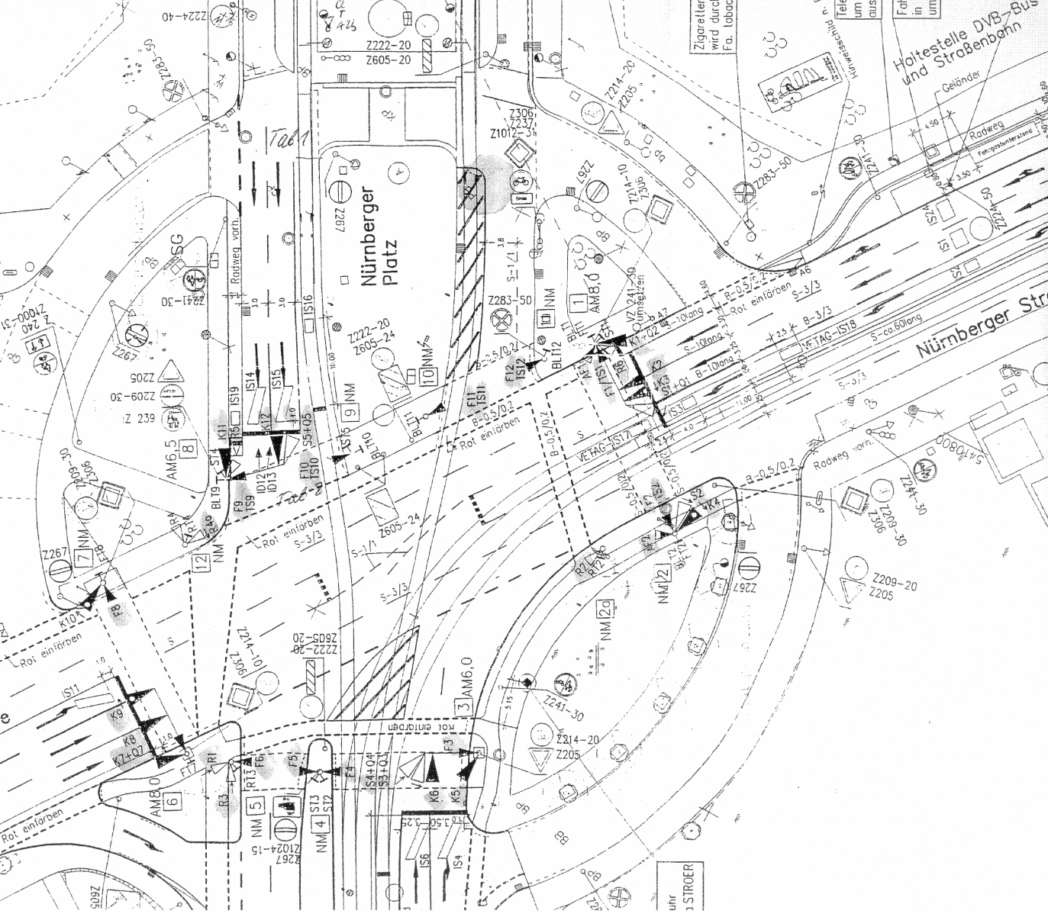
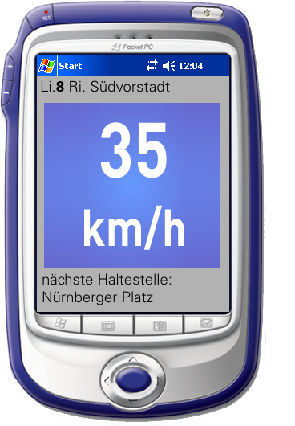
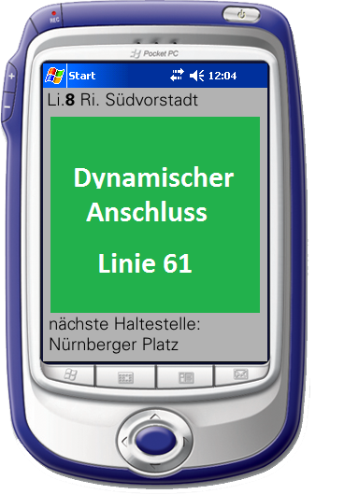
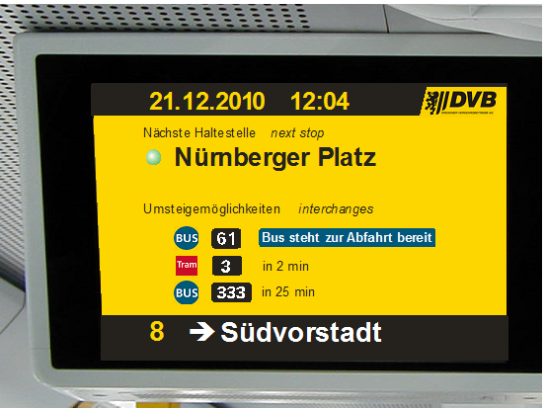
◆ Case Study Nürnberger Platz
Bus line 61 receives message to save connection service to tram line 8
extended green phase for private transport (line 61)
High priority for line 8
Signal timing plan modification - second green phase for tramway
COSEL speed advice for line 8
Information about dynamic connection service
Passenger interchange
8
61

Slide 28
◆ Conclusions and Future Work
Conclusions and Future Work
First cooperative traffic signs considering full Multi-Modal Transport issues and energy efficient driving
Multimodal system in full operation from winter 2010/2011
Extension to the whole North-South-Corridor in Dresden
From 2012
2011/12
2010/11
Notes:
In urban agglomerations ITCS systems and Traffic Control Centres are installed to save high transport quality

